Slide 1
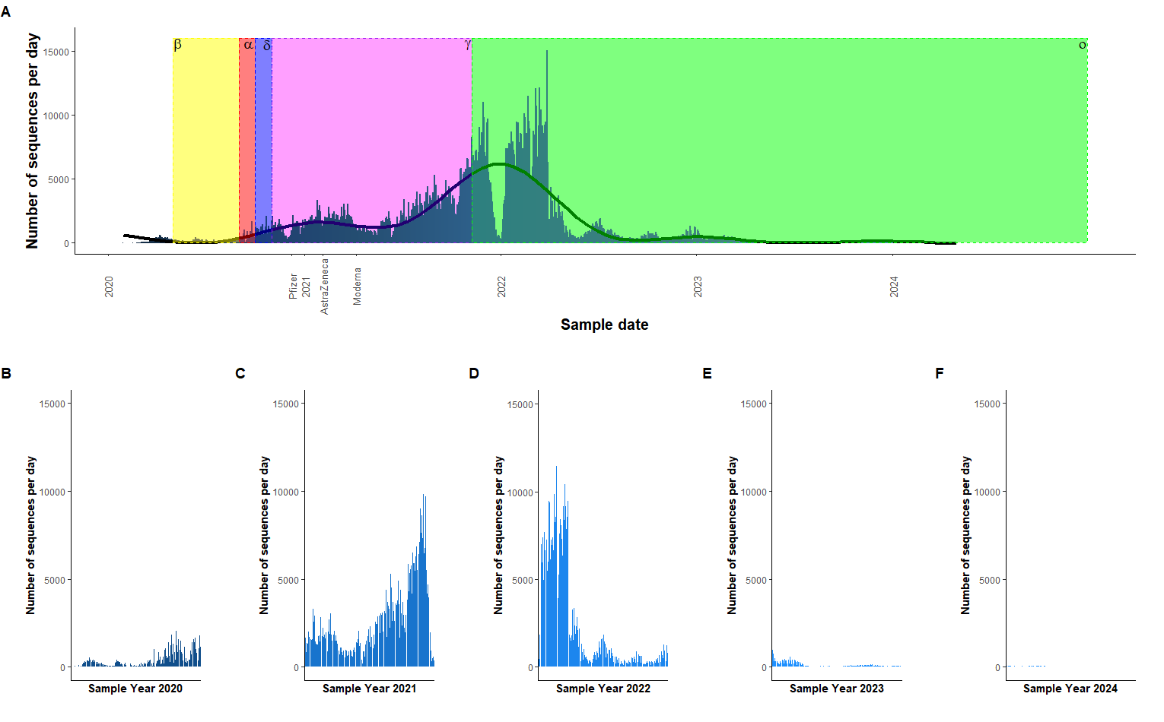
Figure 1. The number of sequences per day from 2020 – 2024. A The overall the number of sequences per day from years 2020 – 2024. The coloured zones represent the emergence of a new strain of SARS-CoV-2. Yellow – beta, red – alpha, purple – delta, pink – gamma, green - omicron. Also on the plot are specific dates showing the first use of that vaccine. A generalised linear model has been used. B The number of sequences per day for 2020. C The number of sequences per day for 2021. D The number of sequences per day for 2022. E The number of sequences per day for 2023. E The number of sequences per day for 2023. F The number of sequences per day for 2024.

Slide 2
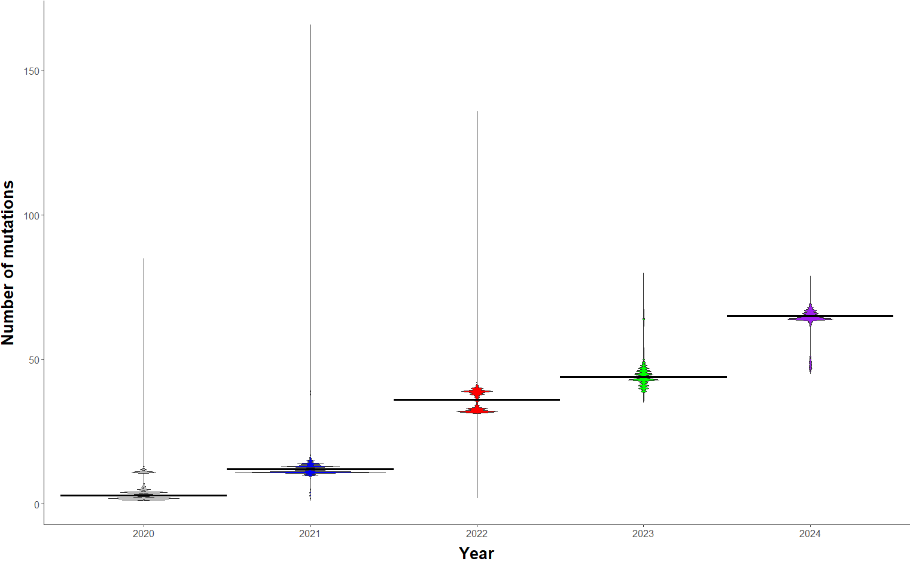
Figure 2. A violin plot, showing the number of mutations per sequence over time. The sequences have been grouped by year. The thicker black line across each distribution represents the median number of mutations per sequence for that year. Median values: 2020 = 3, 2021 = 12, 2022 = 36, 2023 = 44, 2024 = 65. Variance levels: 2020 = 10.7, 2021 = 4.61, 2022 = 12.0, 2023 = 16.7, 2024 = 25.4. There was a significant effect of the year the sequence was taken and the number of mutations per sequence (Kruskal-Wallis: χ2 = 1558575, d.f. = 4, p = 2.2e-16). Post-hoc comparison showed that there were significant differences between all the years. A significance level of 0.05 was used.

